Slide 1
Cobham Wireless
Leaders in Advanced Network Test

Slide 2
Real Data Apps
Overview

Slide 3


The Need for Realistic Application Emulation
To test the capacity, validate new functionality and to optimize the network performance real world conditions need to be emulated
Realistic application emulation is needed because the today’s wireless networks are more and more intelligent and thus traffic will be policed and prioritized differently
This means that the Quality of Experience needs to be evaluated on an per application per UE level for any test scenarios to be meaningful

Slide 4
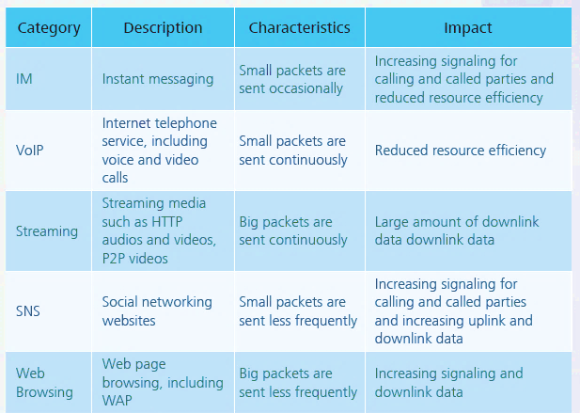
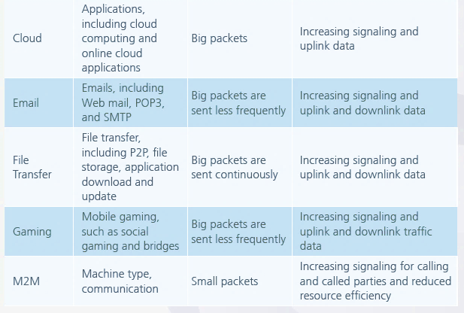

Impact of Different Applications
Huawei-Smarphone-Solutions- july-2012

Slide 5

Intelligent Wireless Networks
Need for Realistic Application Layer Traffic
MEC
Mobile Edge Computing
ADC
Application Detection and Control
SGi-LAN
Service Chaining
LIPA
Local IP Access
SIPTO
Selected Internet Protocol Traffic Offload

Slide 6




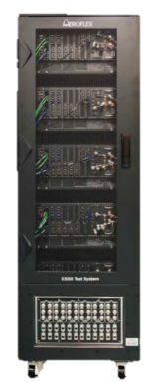













E500 Real Application Testing
Scales cost efficiently
Supports required number of subscribers and application mixes
Supports QoS / QoE analysis
Easy manipulation of various traffic parameters from L1 to L7
MME
HSS
PCRF
SGW
PDN GW

Slide 7






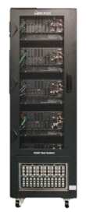






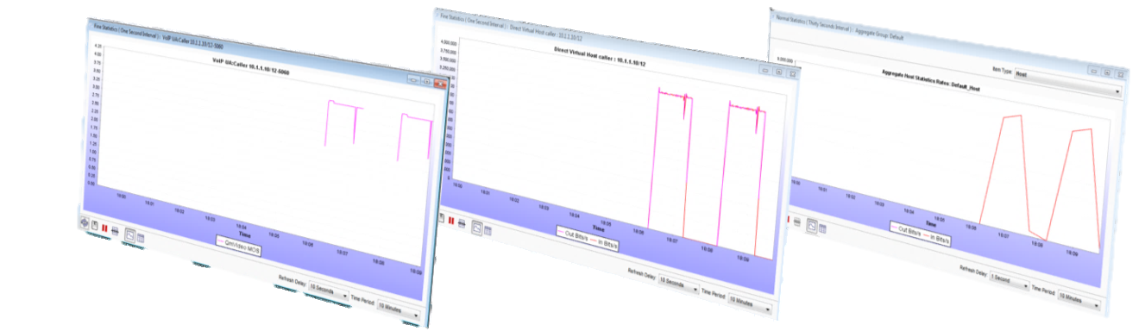
Traffic Generation and Analysis
per Application
per flow performance measurements
per UE
Aggregate performance
per TM/E500
System wide performance

Slide 8
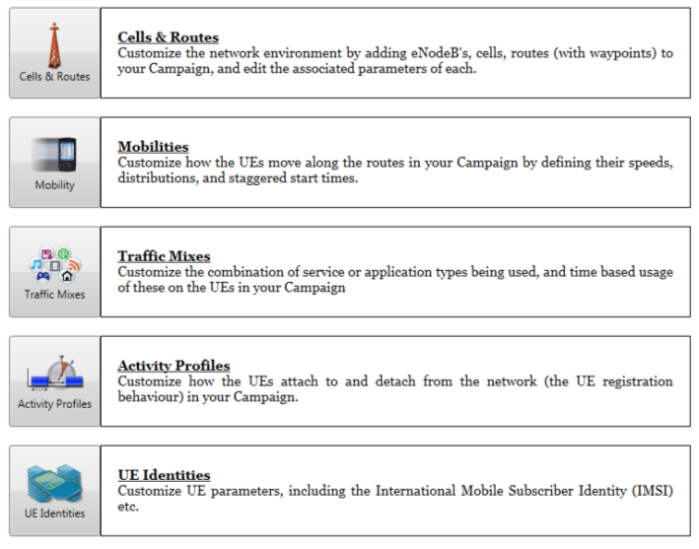
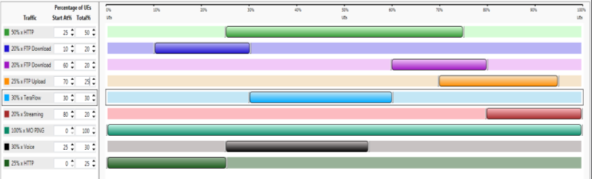
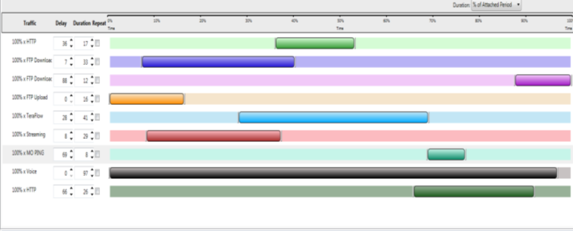

Test Mobile Application
Integrated Control and User Plane GUI
Application per UEs
Application start and stop time

Slide 9
Real Data Apps
Product Structure and Configurations

Slide 10












Real Data Apps Product Structure
Overview
Application Options
Thresholding
Passive Analysis
SMS over IMS
Voice services
Video services
TeraFlow
TWAMP
Traffic Generation Options
3.6Gbps DL Traffic – R630
2.7Gbps DL Traffic – R630
1.8Gbps DL Traffic – R630 or d1000 Edge+Core
HTTP
FTP
900Mbps DL Traffic – d500 Edge+Core
eMail
Ping
450Mbps DL Traffic – d500 Edge
Hardware Platforms
d500
d1000
R630

Slide 11
RDA Platform Overview
d500 – d1000 – R630
d500
I/O – 1x 1Gbps
Fixed VLANs per User
SGi Servers I/O use VLAN tags
Number of UEs
6 000
Number of Applications
24 000 provisioned application clients
12 000 concurrent application clients
Number of PDN connections
12 000
Number of fine statistics
500 entities
d1000
I/O – 2x 1Gbps
Fixed VLANs per User
SGi Servers I/O use VLAN tags
Number of UEs
12 000
Number of Applications
48 000 provisioned application clients
24 000 concurrent application clients
Number of PDN connections
24 000
Number of fine statistics
500 entities
R630
I/O – 2x 10Gbps
Configurable VLANs per User
SGi Servers can be used without VLAN tags
Number of UEs
36 000
Number of Applications
288 000 provisioned and concurrent application clients
Number of PDN connections
72 000
Number of fine statistics
24 000 entities
Near-real time Streaming of statistics

Slide 12
Real Data Apps
Additional Applications

Slide 13
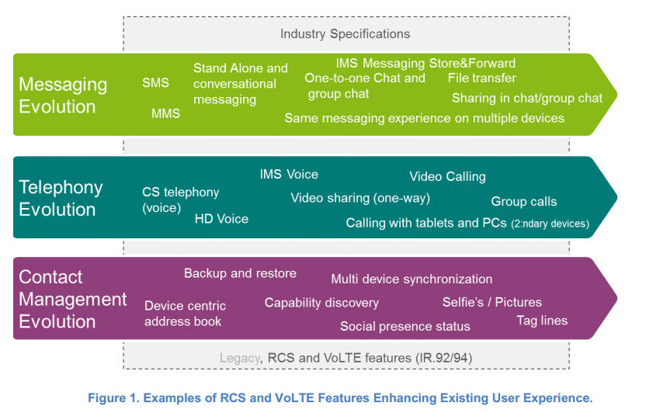
Voice services
Will Voice be “just” data?
Explosive demand, increasing price pressure and OTT competition drive VoLTE
Opens new business opportunities
Helps improve customer experience
Cobham VoLTE option allows emulation of VoLTE UEs with different audio codecs to ensure that the coveted QoE improvements are achieved, VoLTE traffic is prioritized appropriately through the entire network and performance can be optimized
4G Americas VoLTE_RCS TECHNOLOGY ECO-SYSTEM AND EVOLUTION

Slide 14
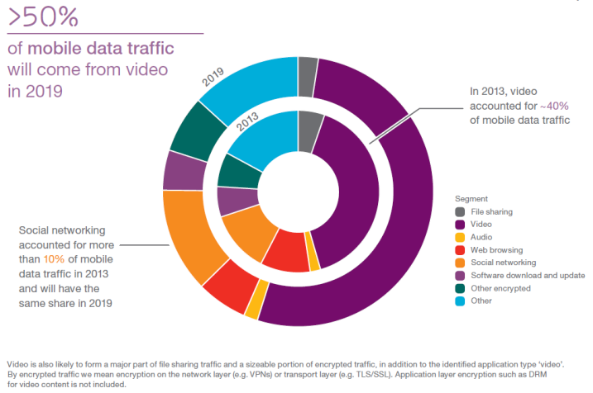
Video services
Video on demand (VoD) and video streaming (VS) are the most popular applications in LTE networks and thus are under most scrutiny for quality of experince.
Cobham Video service option allows emulation of UEs connecting to VoD or VS servers as well as emulation of these servers to see the impact on the network performance or to see the network impact on the Video service performance.
Cobham implementation supports multiple Audio and Video codecs which allows users to test with scenarios that reflect their own network or to evaluate planned deployment performance.
Ericsson-mobility-report-june-2014

Slide 15
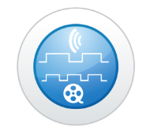
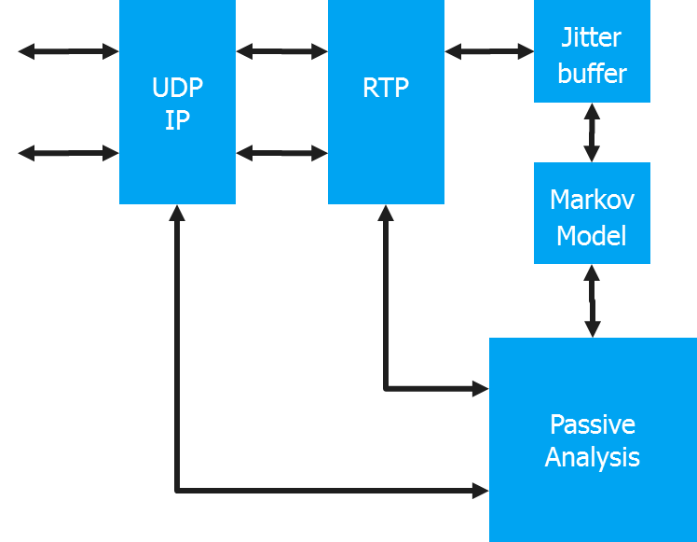
Media & Voice Passive Analysis
Service’s overall quality is how the video or the audio quality is perceived by consumers. This is typically examplified with Mean Opinion Score (MOS). Cobham’s Passive Analysis option allows to quantify how network layer imperfections affect this quality of experience (QoE) factor.
Cobham implementation supports both audio and video quality analysis and also uses:
Jitter Buffer models real UE packet queuing and playback effects to
detect lost packet
Predict which packets would be discarded
Markov Model to statistically learn the distribution of lost and discarded packets during a call, and then apply this distribution for MOS calculation

Slide 16
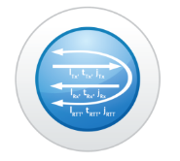
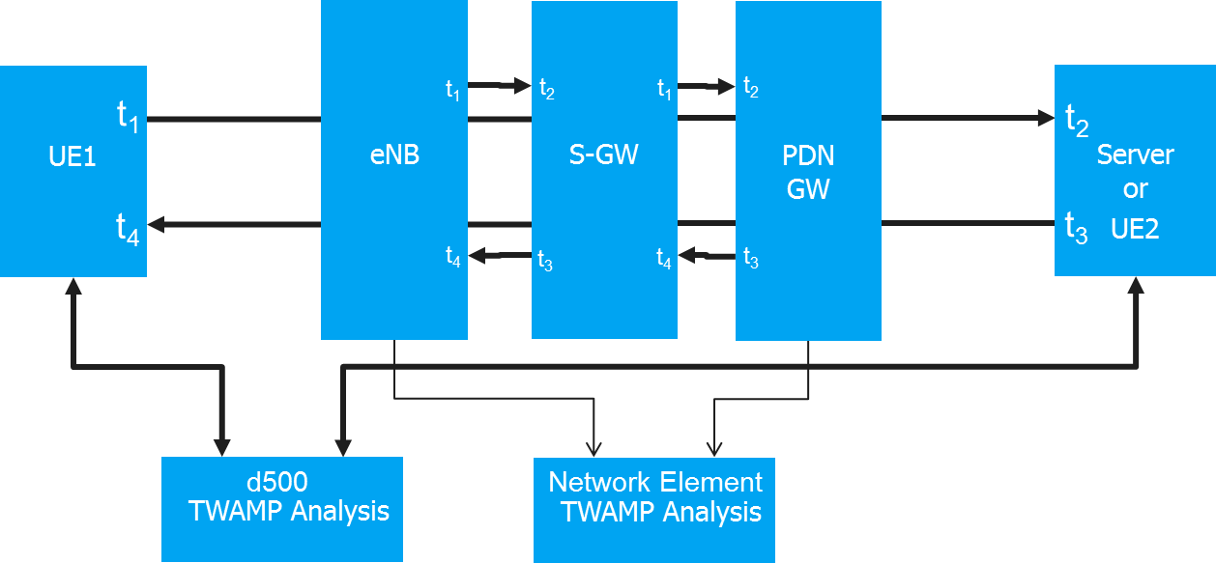
TWAMP – Two Way Active Measurement
Measuring the performance of IP networks is a challenge
Standard tools were designed for simple troubleshooting
The Two-Way Active Measurement Protocol (TWAMP)
defines a flexible method for measuring round trip IP performance among any two devices in a network that support the standard
provides a flexible choice of solutions and full visibility into network performance
Cobham TWAMP option is
Compliant to work with any network element that supports TWAMP
Allows measurements between any two endpoints
IP performance can be measured effectively at all locations in the network
Notes:
Measuring the performance of IP networks through the use of standard protocols has always been a challenge.
The inventors of IP provided some tools, such as ICMP Ping, Traceroute and UDP Echo, as part of the TCP/IP suite of protocols.
Measuring the performance of IP networks through the use of standard protocols has always been a challenge. These tools were not intended to conduct overall performance measurements but were designed for simple troubleshooting of IP networks.
The Two-Way Active Measurement Protocol (TWAMP) defines a flexible method for measuring round-trip IP performance among any two devices in a network that support the standard.
TWAMP provides a flexible choice of solutions and full visibility into network performance
It is compliant to work with the routers and switches in the network.
Any two endpoints can interoperate and therefore obviate the need for managers to deploy systems with closed proprietary protocols for measuring performance.
Standards-based performance measurement protocols to create an ecosystem where IP performance metrics are obtained through cooperation among network elements.
Through the use and deployment of TWAMP the IP performance can be measured effectively at all locations.

Slide 17


Thresholding
Cobham Thresholding Option
automatically determines if the expected performance criteria has not been met during testing
Saves time by identifying what, where and when it has been outside of tolerance
Allows monitoring of multiple applications simultaneously with different criteria
Different UE groups (for example VIP customers and data only subscriptions) can have individual criteria
Setting up different violation and clearance duration

Slide 18

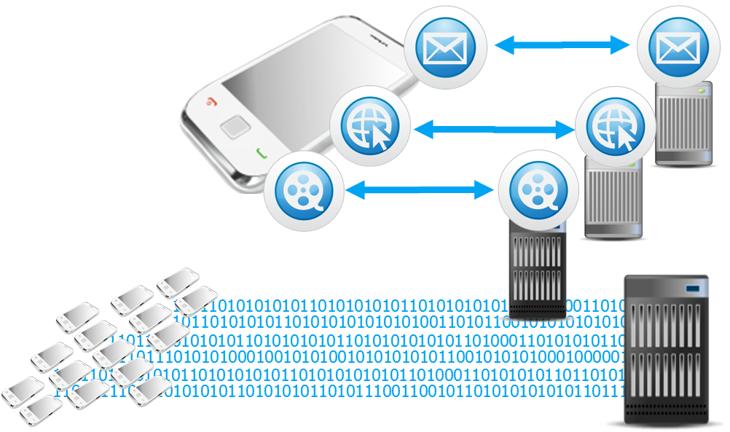
TeraFlow
Cobham TeraFlow Option creates TCP and/or UDP protocol traffic. This allows easily create “background” traffic while validating that other applications maintain acceptable level of performance.
Cobham TeraFlow Option
Generation of traffic at pre-defined level
Mirroring the UE data back for bi-directional measurement
Can be configured and turned On and Off per UE

Slide 19

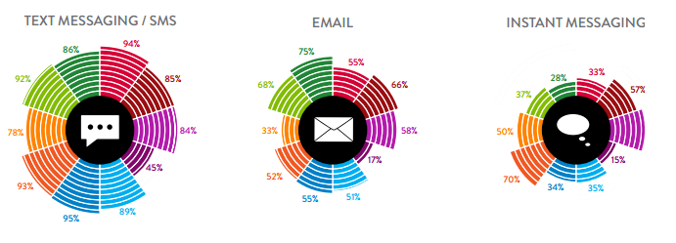
SMS over IMS
The IP Multimedia System (IMS) is not only used for VoLTE, but also to deliver other services such as traditional messaging services (SMS).
Cobham SMS option allows emulation UEs to connect to IMS SMS servers and ensure that the coveted integration of SMS services function properly and transmission and reception of SMS messages works properly through the entire network.
Nielsen Mobile-Consumer-Report-2013

Slide 20
Real Data Apps
Sales Collateral

Slide 21
RDA R630 Sales Collateral
Real Data Apps Sales Presentation
TM500 RDA d500 Edge Datasheet
E500 6 Cell RDA d500 Edge+Core Datasheet
E500 12 Cell RDA d1000 Edge+Core Datasheet
E500-D 24 Cell RDA R630 Datasheet
TM500 LTE/WCDMA Load Tester diversifEye Reference Manual
Voice Analysis for Mobile Networks White Paper

